Slide 1
RGB histogram for FER datasets
Junyeob Kim

Slide 2
Motivation
Performance of a deep learning model may differ with different RGB distribution.
Assumption - an RGB distribution can be represented as gaussian mixture models.
Need to investigate whether each dataset, or each facial expression, has different RGB distribution.
Two datasets are used – MMI selected and KDEF

Slide 3
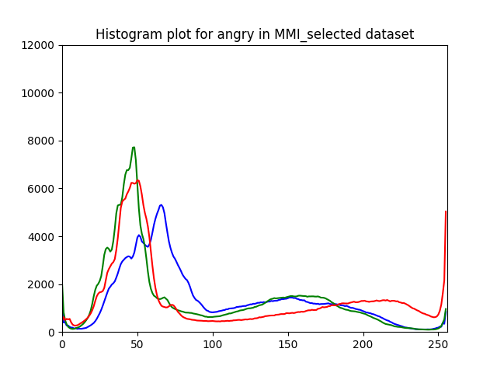
MMI Selected
5 facial expressions
Angry – 33 images
Frown – 37 images
Sad – 74 images
Smile – 70 images
Surprise – 53 images
One Gaussian distribution is observed
Some of these distributions have more than one peak – mixture of gaussian distribution.
Figure 1 – RGB distribution of ‘Angry’ expression in MMI selected dataset

Slide 4
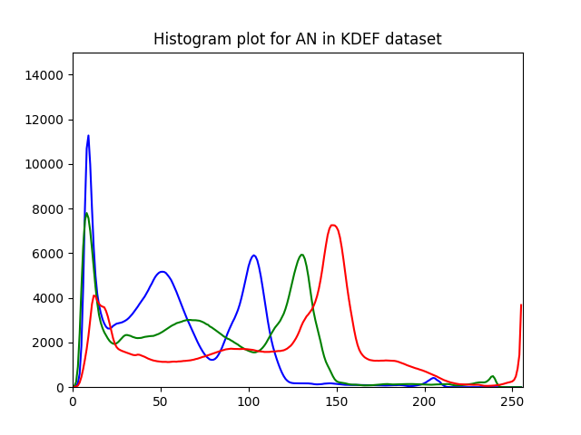
KDEF
6 facial expressions
Angry – 140 images
Disgusted – 140 images
Happy – 140 images
Neutral – 140 images
Sad – 139 images
Surprise – 140 images
Two or three gaussian distributions observed
Number depends on the colour (Blue, Green or Red)
Figure 1 – RGB distribution of ‘Angry’ expression in KDEF dataset

Slide 5
Conclusion
Two datasets have different RGB distributions.
Within a dataset, no significant difference is observed for each facial expressions.
Therefore, if there is an optimal deep learning model for each dataset, there must be some correlations between number of mixture of gaussian distributions and performance of deep learning models.

Slide 6
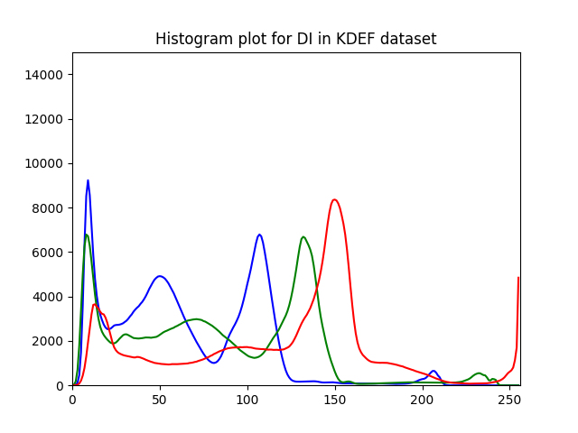
Appendix – RGB distribution plots

Slide 7
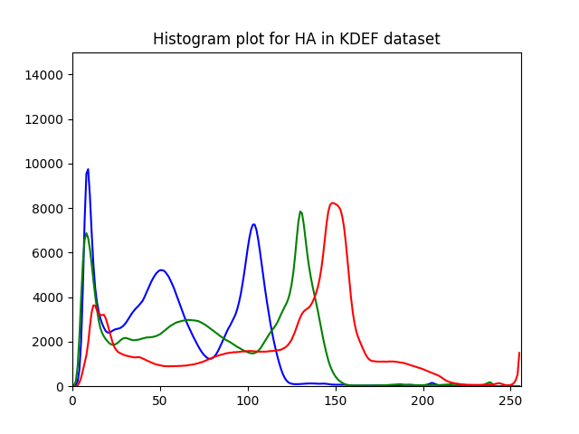
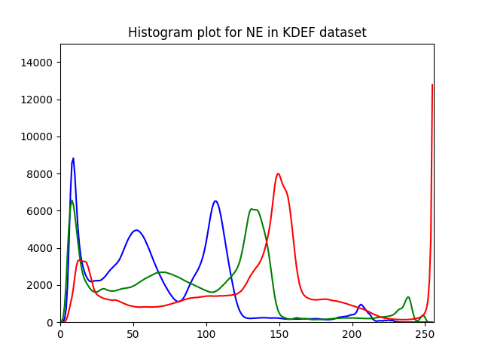
Appendix – RGB distribution plots

Slide 8
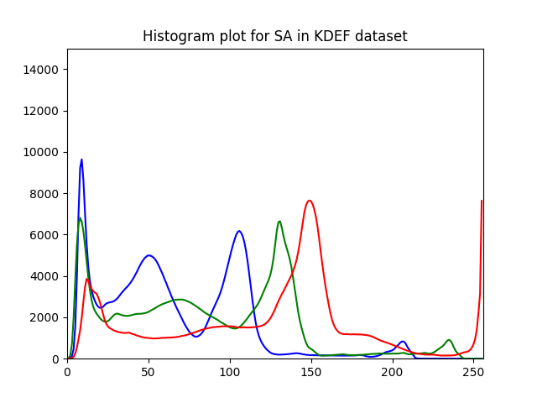
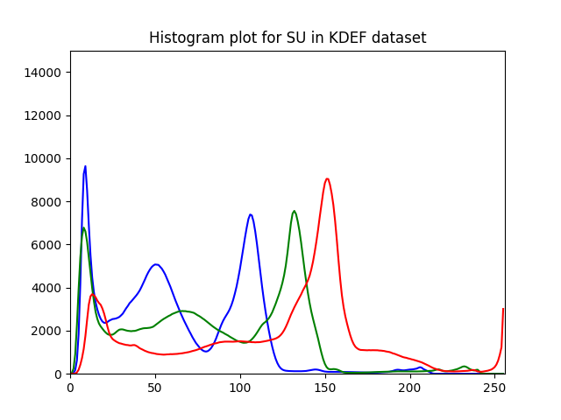
Appendix – RGB distribution plots

Slide 9
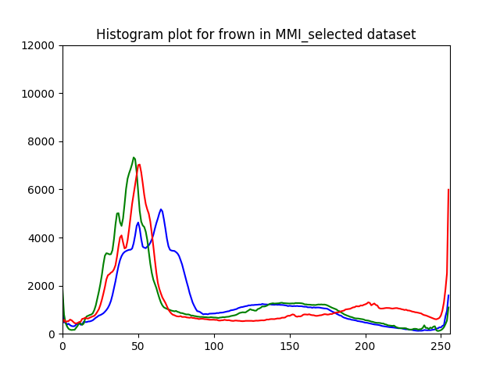
Appendix – RGB distribution plots

Slide 10
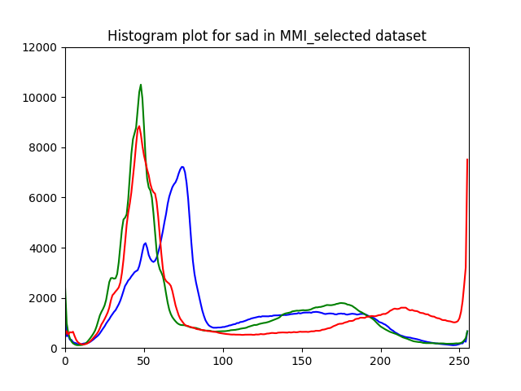
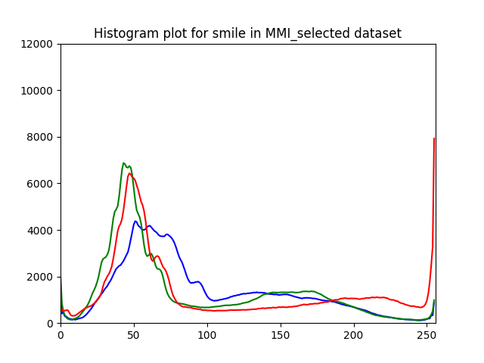
Appendix – RGB distribution plots

Slide 11
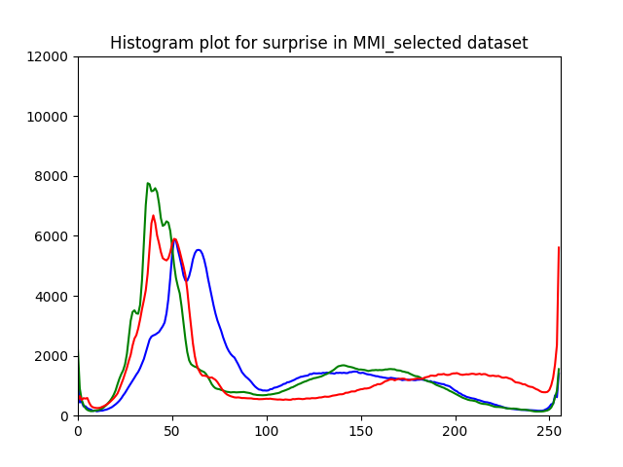
Appendix – RGB distribution plots

